Slide 1
Python

Slide 2
Objective
What is python?
Why we use python?
Benefits of python - compare to other programming languages
What is IDE?
Python IDE’s

Slide 3
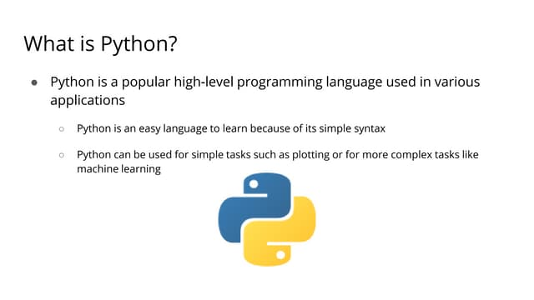

Slide 4
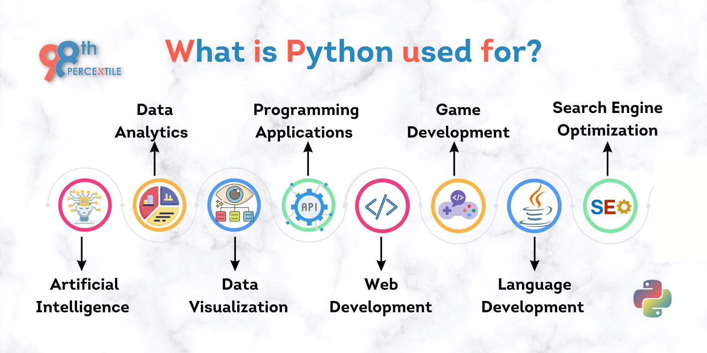
Python-Use

Slide 5
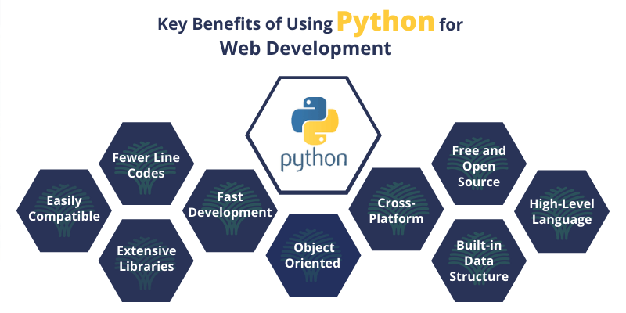

Slide 6
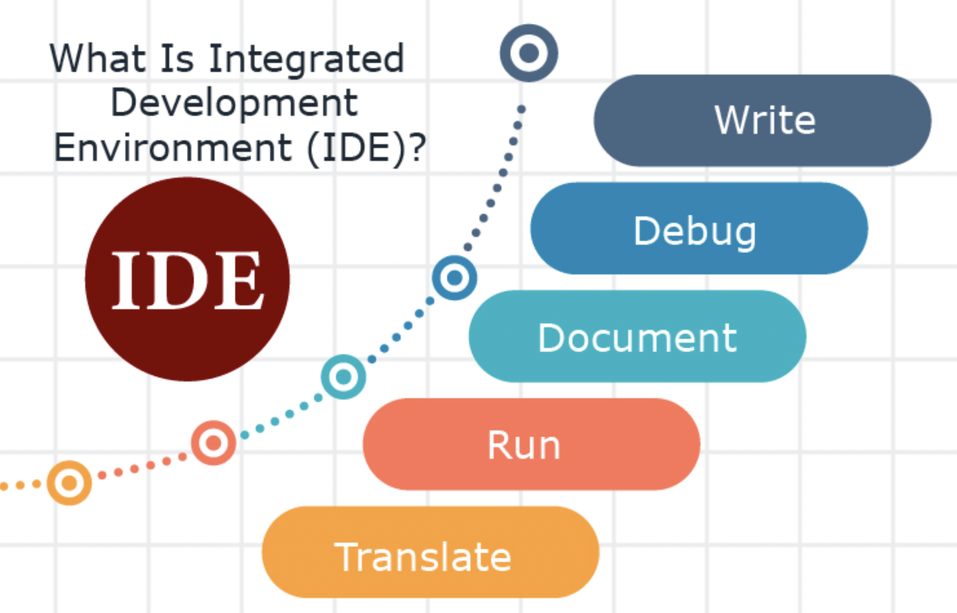

Slide 7

https://www.anaconda.com/download

Slide 8

https://www.jetbrains.com/pycharm/download/?section=windows

Slide 9

https://code.visualstudio.com/download

Slide 10
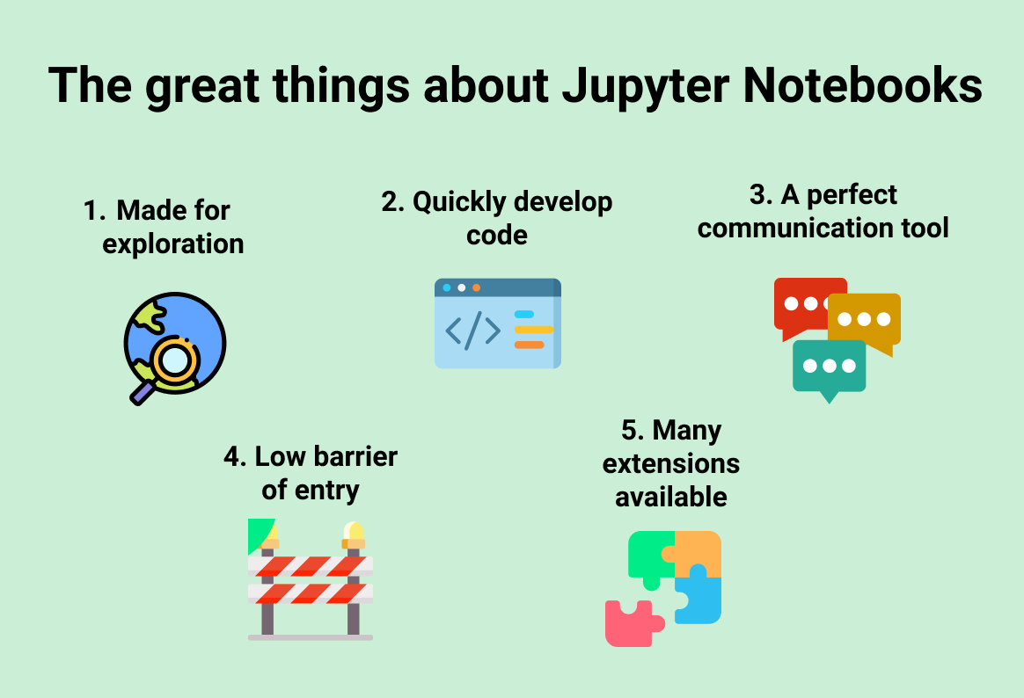

Slide 11
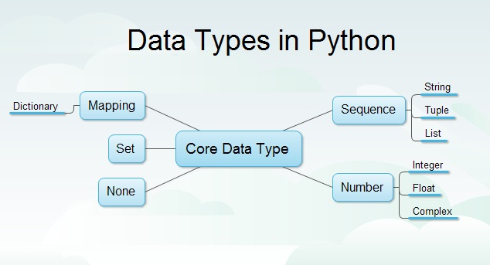

Slide 12
Data Types
Int – It is numeric value, the range of value lies between 0-9
Syntax: Variable Name assignment operator value
daily_sale_value=100
Float- it is numeric value with decimal points, the range of value lies between 0-9 decimals 0-9
Syntax: Variable Name assignment operator value
daily_average_sale_value=100.0567
String –It is character values, the range of the character are A-Z, a-z
Syntax: Variable Name assignment operator value
name= ‘param’
Name=‘param athame’
Story= ‘’this is my
First story ‘’’
String with delimiters – it is character values, the range of character are A-Z, a-z and 0-1 and !@#$%^&*(){}|”?>< etc.

Slide 13
Data Types –Sequence Type
List – Group of values either int or char data types
Syntax: variablename =[ val1,val2,…,val3] or variablename =[ ‘val1’,’val2’,…,’val3’]
Tuple – Group of values either int or char data types
Syntax: variablename =( val1,val2,…,val3) or variablename =(‘val1’,’val2’,…,’val3’)
Set – Group of values either int or char data types
Syntax: variablename ={val1,val2,…,val3} or variablename ={‘val1’,’val2’,…,’val3’}
Dictionary – Group of values either int or char data types with index
Syntax: variablename ={“key”:”key_value”}

Slide 14
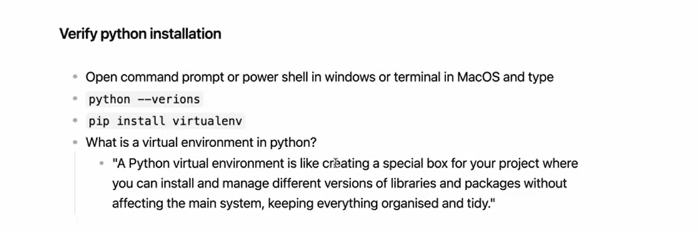

Slide 15
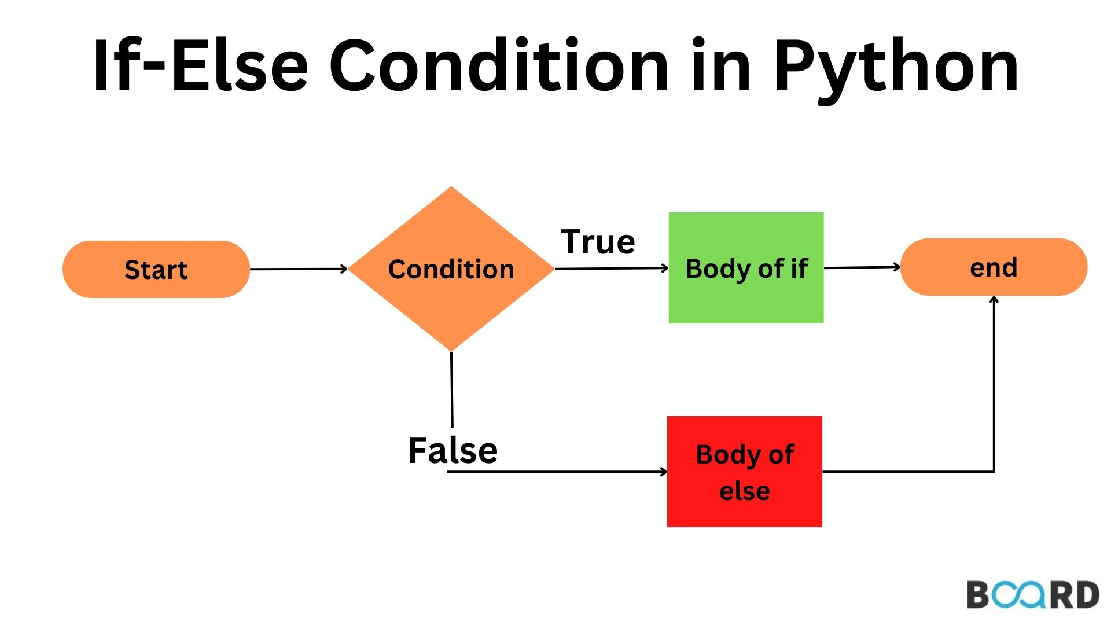

Slide 16
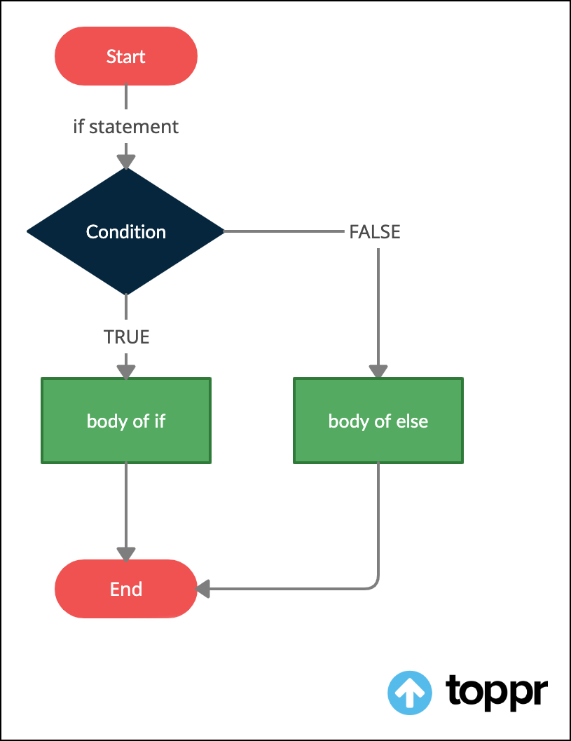

Slide 17
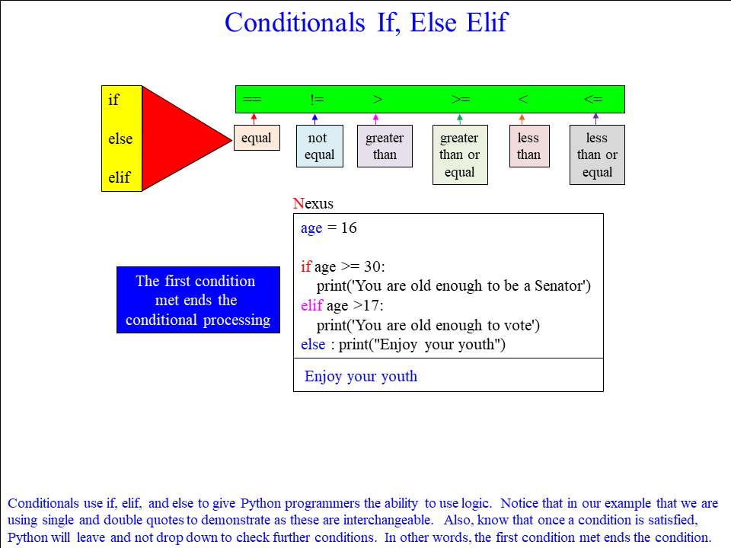

Slide 18
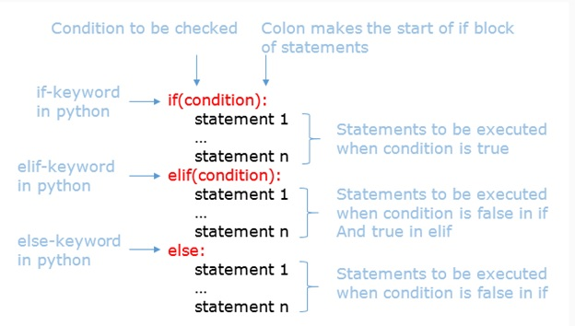

Slide 19
Loops

Slide 20
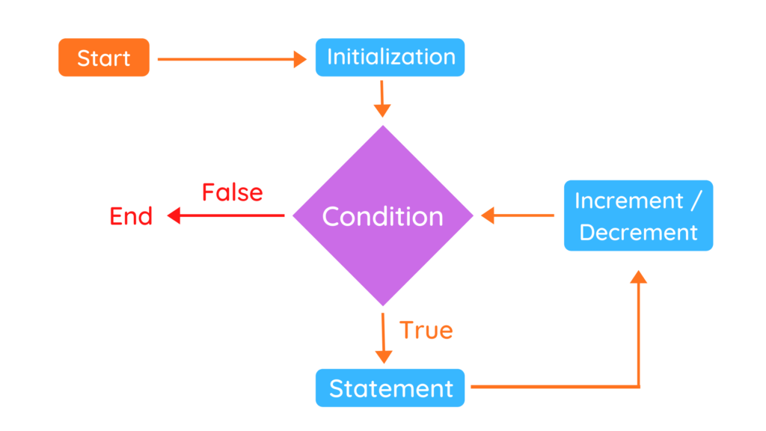

Slide 21
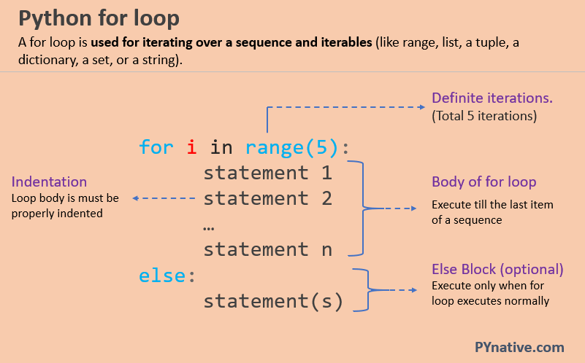

Slide 22
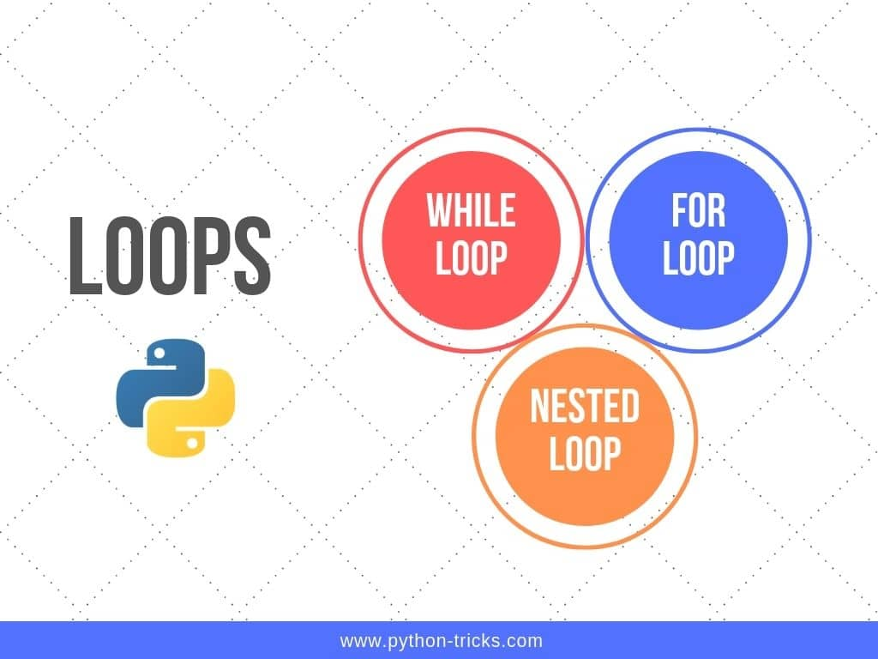

Slide 23
Functions
Python Functions is a block of statements that return the specific task.
Increase Code Readability
Increase Code Reusability

Slide 24
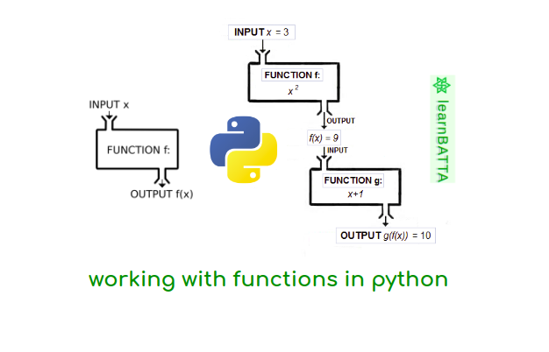

Slide 25
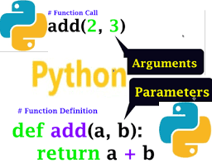
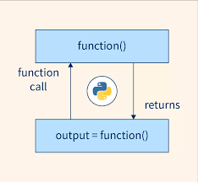

Slide 26
Python Built functions
Numeric Functions/ Mathematical Functions
abs()→ Returns the absolute value of a number
ceil()→ Return round up higher value
floor()→ Return round down lower value
round()→ Round the decimal values
String Functions
Statistical Functions
Min()→ Return minimum value
Max()→ Return maximum value
Sum()→

Slide 27

GitHub

Slide 28
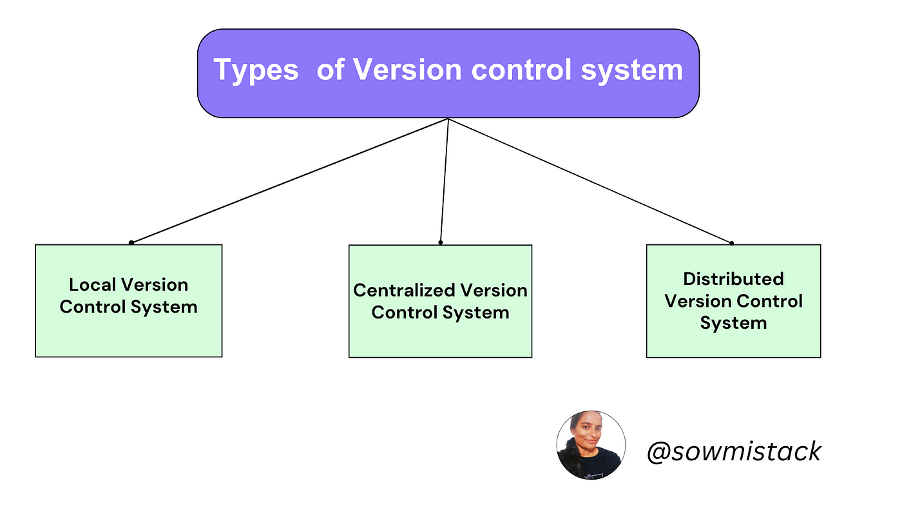

Slide 29
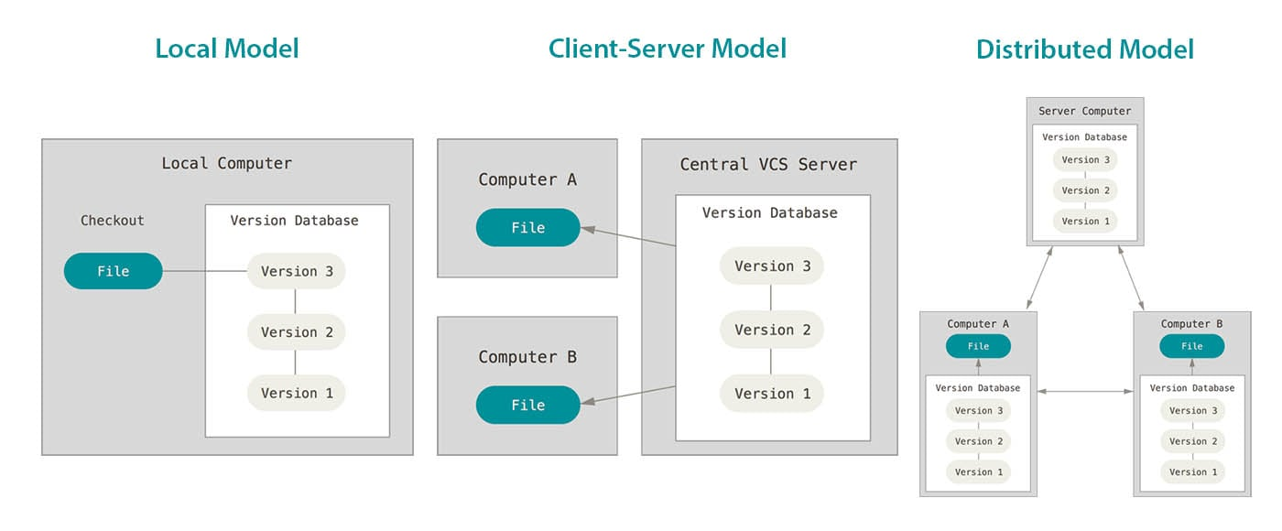

Slide 30
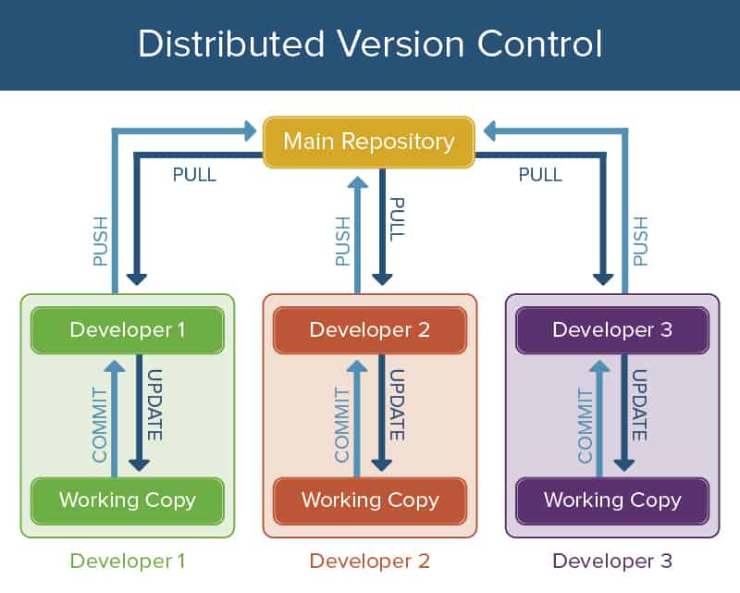

Slide 31
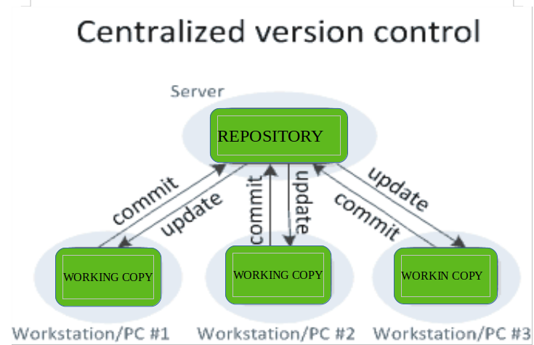

Slide 32
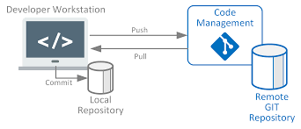
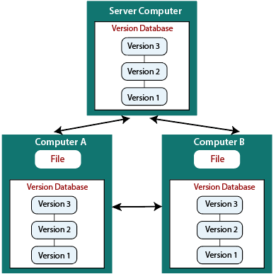

Slide 33
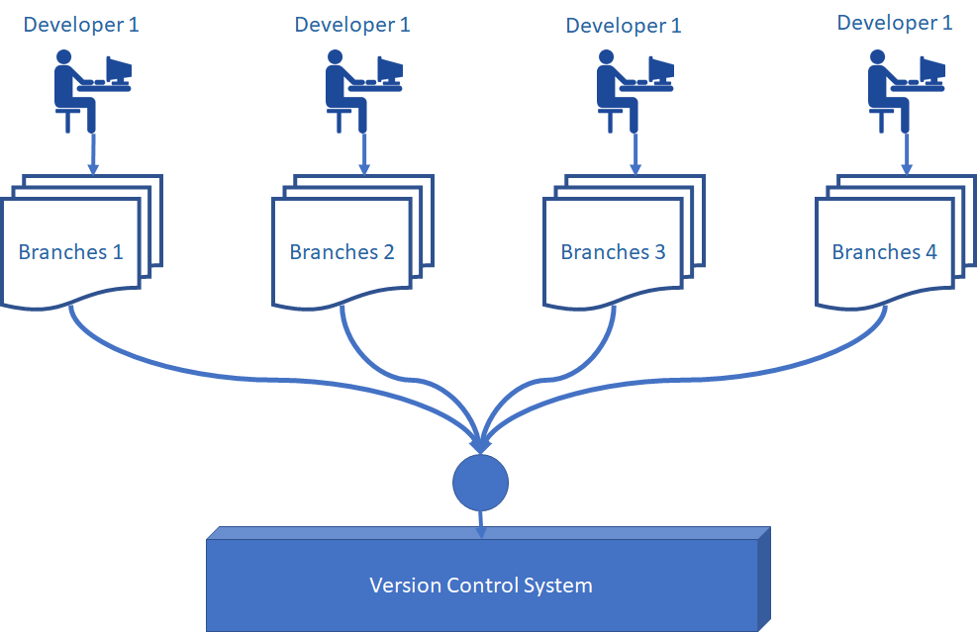

Slide 34


Slide 35
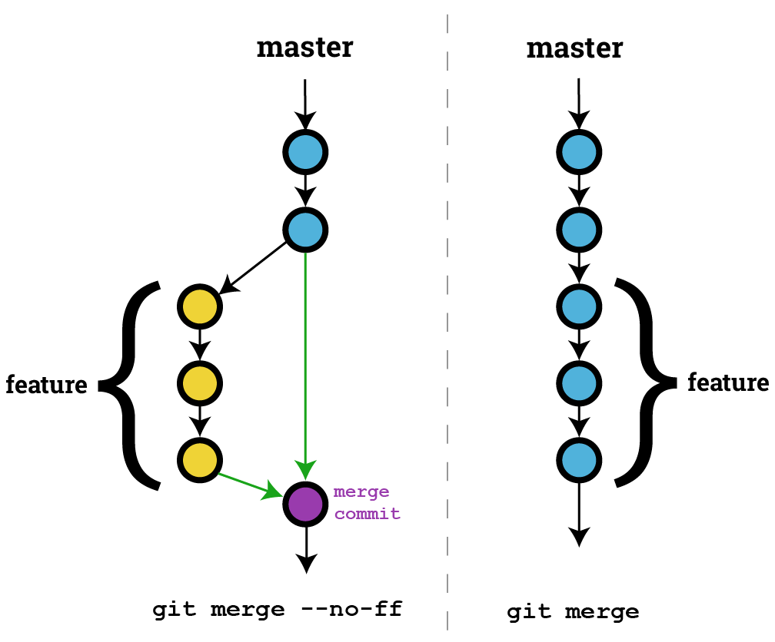

Slide 36
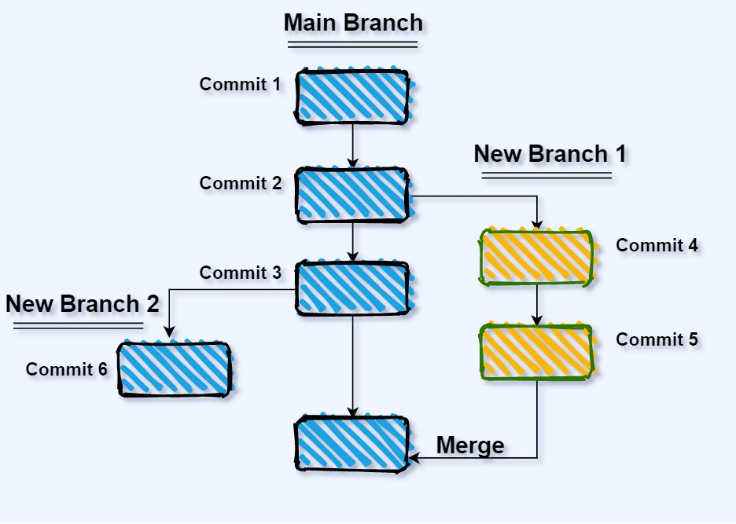

Slide 37
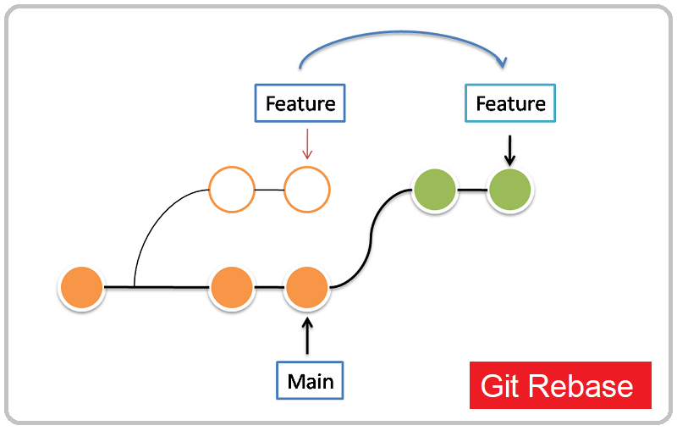

Slide 38
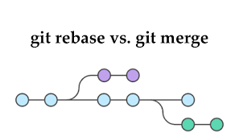

Slide 39
Git Commands
Git clone: Creates a copy of an existing Git repository. Cloning is the most common way for developers to obtain a working copy of a central repository.
Git commit: Takes the staged snapshot and commits it to the project history. Combined with git add, this defines the basic workflow for all Git users.
git config: A convenient way to set configuration options for your Git installation. You’ll typically only need to use this immediately after installing Git on a new development machine.
git fetch: Fetching downloads a branch from another repository, along with all of its associated commits and files. But, it doesn't try to integrate anything into your local repository. This gives you a chance to inspect changes before merging them with your project.
git init: Initializes a new Git repository. If you want to place a project under revision control, this is the first command you need to learn.

Slide 40
Git Commands
git log: Lets you explore the previous revisions of a project. It provides several formatting options for displaying committed snapshots.
git merge: A powerful way to integrate changes from divergent branches. After forking the project history with git branch, git merge lets you put it back together again.
git pull : Pulling is the automated version of git fetch. It downloads a branch from a remote repository, then immediately merges it into the current branch. This is the Git equivalent of svn update.
git push : Pushing is the opposite of fetching (with a few caveats). It lets you move a local branch to another repository, which serves as a convenient way to publish contributions. This is like svn commit, but it sends a series of commits instead of a single changeset.
git rebase: Rebasing lets you move branches around, which helps you avoid unnecessary merge commits. The resulting linear history is often much easier to understand and explore.
git reset :Undoes changes to files in the working directory. Resetting lets you clean up or completely remove changes that have not been pushed to a public repository.
git revert :Undoes a committed snapshot. When you discover a faulty commit, reverting is a safe and easy way to completely remove it from the code base.

Slide 41
Git Commands
git status: Displays the state of the working directory and the staged snapshot. You’ll want to run this in conjunction with git add and git commit to see exactly what’s being included in the next snapshot.
Git checkout : In addition to checking out old commits and old file revisions, git checkout is also the means to navigate existing branches. Combined with the basic Git commands, it’s a way to work on a particular line of development.
Git branch: This command is your general-purpose branch administration tool. It lets you create isolated development environments within a single repository.
Git add: Moves changes from the working directory to the staging area. This gives you the opportunity to prepare a snapshot before committing it to the official history.

Slide 42
Git References
https://www.atlassian.com/git/glossary#commands
https://git-scm.com/docs/git
https://dzone.com/articles/top-20-git-commands-with-examples
https://www.javatpoint.com/git-commands

Slide 43
OOPs(Object Oriented Programming)
OOPs:
An object-oriented paradigm is to design the program using classes and objects. The object is related to real-word entities such as book, house, pencil, etc. The oops concept focuses on writing the reusable code. It is a widespread technique to solve the problem by creating objects.
There is design we can use same design for multiple purpose and iterations with design objects

Slide 44
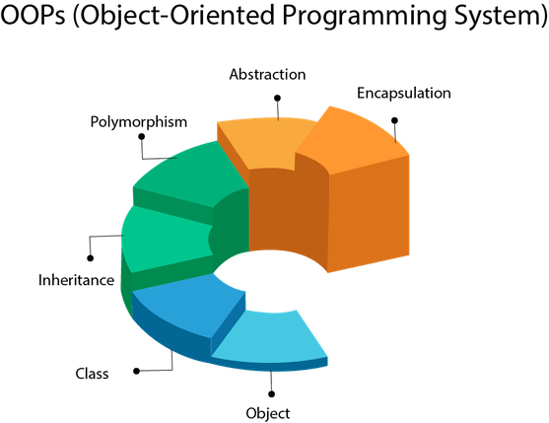

Slide 45
Class
It is a blue print to create objects
The object is base class in python
The class keyword is used to create class
Python constructor is defined with __init__() method
Python does not support multiple constructor in a class
I,e No constructor overloading

Slide 46




Class as Blue Print
Action Movie:
Actor: Raju
Actress: Rose
Producer: Param
Director: Shiva
Family Drama :
Actor: Ratna Babu
Actress: Ramya
Producer: Param
Director: Sai
Movie
Actor
Actress
Producer
Director
Fictional Movie:
Actor: Rajasekar
Actress: Rani
Producer: Param
Director: Aleem

Slide 47
Constructor in Python
A constructor in python is a special type of method which is used to initialize the instance member of class
The constructor execute the first when you call the class obects.
Only one constructor for class
No constructor overloading in a class
Constructor name start with __init__()
Syntax:
Class classname:
def __init__():
<body>

Slide 48
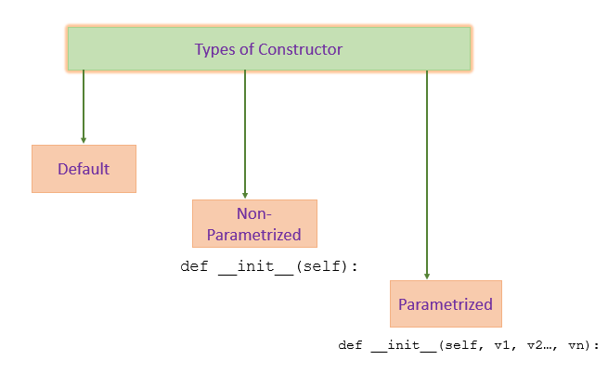

Slide 49
Object
An Object is an instance of a Class.
A class is like a blueprint while an instance is a copy of the class with actual values. Python is an object-oriented programming language that stresses objects
i.e. it mainly emphasizes functions.
Python Objects are basically an encapsulation of data variables and methods acting on that data into a single entity.
An object is variables or functions

Slide 50
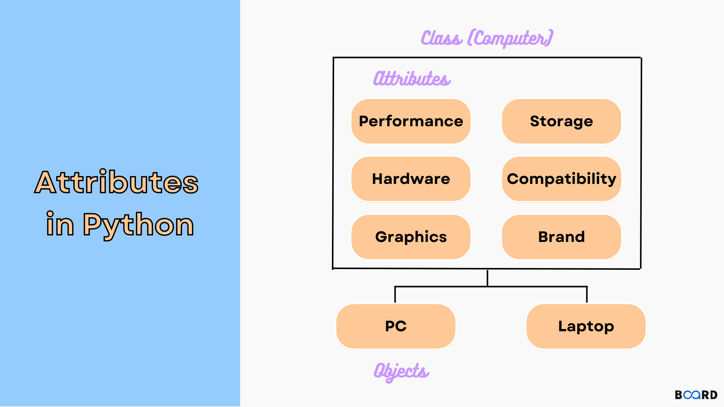

Slide 51
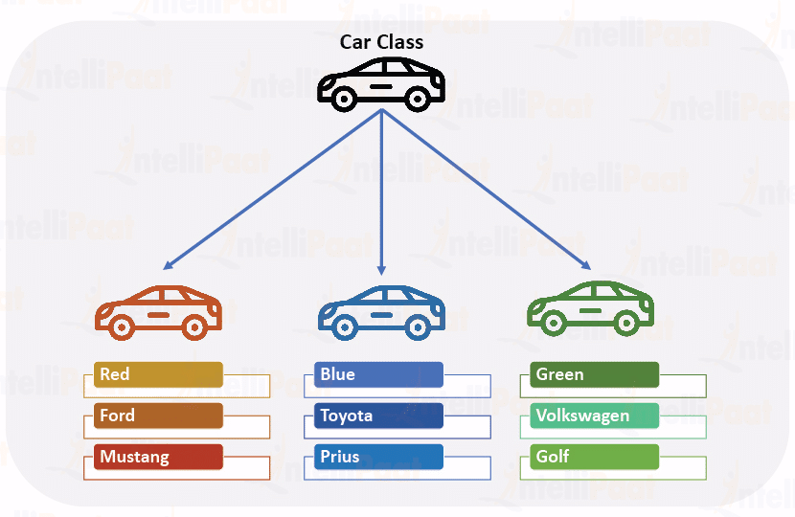
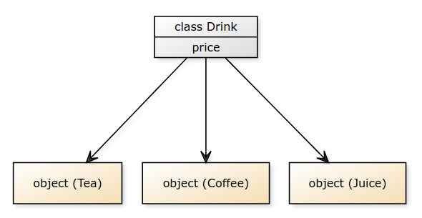

Slide 52
Inheritance
It is a mechanism that allows you to create a hierarchy of classes that share a set of properties and methods by deriving a class from another class. Inheritance is the capability of one class to derive or inherit the properties from another class.
It represent real world relationship well
It provides reusability of the code, we don’t have to write same code again and again.
It is transitive in nature. which means class B inherits from class A.
It offers simple, understandable model structure.
Less development and maintenance expenses result from an inheritance

Slide 53
Inheritance Types
Inheritance is defined as the mechanism of inheriting the properties of the base class to the child class. Here we a going to see the types of inheritance in Python.
Types of Inheritance depend upon the number of child and parent classes involved. There are four types of inheritance in Python:
Single inheritance enables a derived class to inherit properties from parent class, thus enabling code reusability.
Multiple inheritance, a class is derived from the other class, parent class properties use in child class
Muli-level inheritance, a class is derived from the subsequent classes. There are multiple parents classes for child class.
Hierarchal inheritance, there are more than one derived class for a base class is called Hierarchal inheritance.
Hybrid or Cycle inheritance: There are combination of inheritance. Which can makes cycle or hybrid.

Slide 54
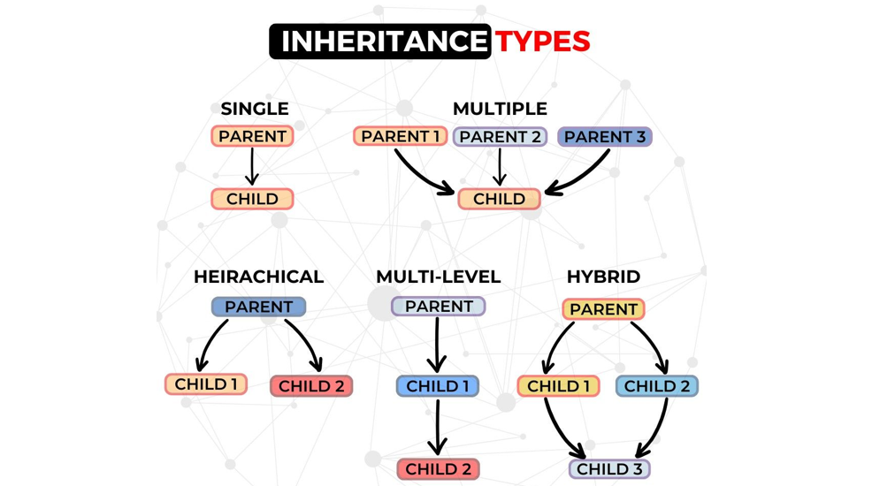

Slide 55
Single Inheritance
Parents
Childs

Slide 56
Fashion Industry
Fashion ware
Cultural ware, Traditional ware
Western ware
Shirt Pant, coat set

Slide 57
Example Code
class Parent:
def func1(self):
print("This function is in parent class.")
# Derived class
class Child(Parent):
def func2(self):
print("This function is in child class.")
# Driver's code
object = Child()
object.func1()
object.func2()

Slide 58
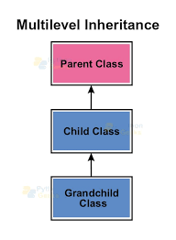
Multi-level Inheritance
Western Wear
Coat set
Blazer
Slim fit, formal wear, waist coat

Slide 59
Multiple Inheritance
When a class can be derived from more than one base class this type of inheritance is called multiple inheritances.
In multiple inheritances, all the features of the base classes are inherited into the derived class.
A class can be derived from more than one superclass in Python. This is called multiple inheritance.
By using inheritance, we can achieve the reusability of code, relationships between the classes.
If we have three classes A, B, and C where A is the superclass (Parent), B is the subclass (child), and C is the subclass of B (Grandchild).

Slide 60
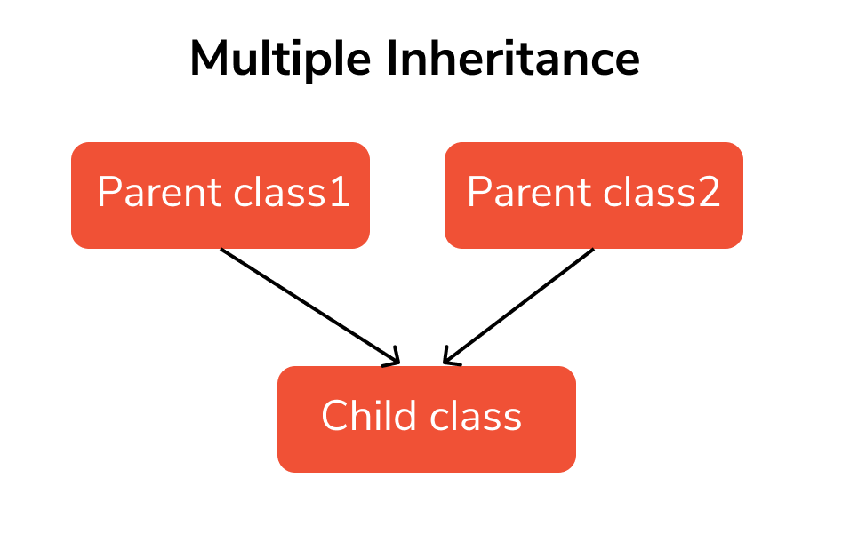
Fashion Wear
Traditional Wear
Western Wear
Cultural Wear

Slide 61
Multiple Inheritance:
When a class can be derived from more than one base class this type of inheritance is called multiple inheritances.
In multiple inheritances, all the features of the base classes are inherited into the derived class.
A class can be derived from more than one superclass in Python. This is called multiple inheritance.
In Python, not only can we derive a class from the superclass but you can also derive a class from the derived class.

Slide 62
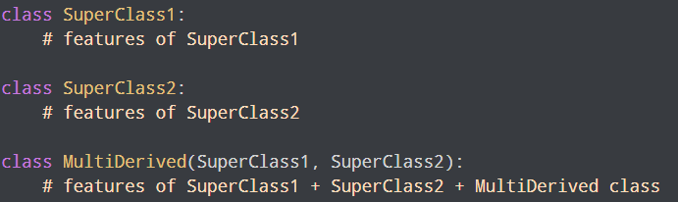
Syntax

Slide 63
Method Resolution Order (MRO) in Python
If two superclasses have the same method (function) name and the derived class calls that method,
Python uses the MRO to search for the right method to call.
The super1 and super2 both of these classes define a method info()
So when info() is called using the object of the derived class, python uses the MRO to determine which method to call
In this case, the MRO specifies that methods should be inherited from the leftmost superclass first, so info() of superclass1 is called rather than that of superclass2.

Slide 64
Hierarchical Inheritance
When more than one derived class are created from a single base this type of inheritance is called hierarchical inheritance.
In this program, we have a parent (base) class and two child (derived) classes.
If multiple derived classes are created from the same base, this kind of Inheritance is known as hierarchical inheritance.
In this instance, we have two base classes as a parent (base) class as well as two children (derived) classes

Slide 65
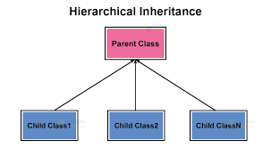
Hierarchical Inheritance
Fashion Wear
Men Wear
Women Wear
Kids Wear

Slide 66
Hybrid Inheritance
Inheritance consisting of multiple types of inheritance is called hybrid inheritance.
Hybrid Inheritance is a blend of more than one type of inheritance. The class is derived from the two classes as in the multiple inheritance.
However, one of the parent classes is not the base class. It is a derived class. This feature enables the user to utilize the feature of inheritance at its best.
This satisfies the requirement of implementing a code that needs multiple inheritances in implementation.

Slide 67
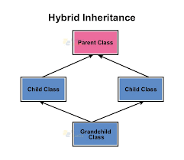
Hybrid Inheritance
Multi-Level
Western Wear
Multiple
Coat set
Traditional Wear
Blazer,Kurta

Slide 68
Abstract Method
Python OOPs which is used to hide irrelevant details from the user and show the details that are relevant to the users
Data Abstraction in Python
Data abstraction in Python is a programming concept that hides complex implementation details while exposing only essential information and functionalities to users.
Abstraction classes in Python
Abstract class is a class in which one or more abstract methods are defined. When a method is declared inside the class without its implementation is known as abstract method.

Slide 69
Syntax
from abc import ABC, abstractmethod
class BaseClass(ABC):
@abstractmethod
def method_1(self):
#empty body
pass

Slide 71
Concrete Method: Concrete methods are the methods defined in an abstract base class with their complete implementation. Concrete methods are required to avoid reprication of code in subclasses.

Slide 72
Polymorphism
The word polymorphism means having many forms. In programming, polymorphism means the same function name (but different signatures) being used for different types. The key difference is the data types and number of arguments used in function.
Inbuilt Polymorphism
# Python program to demonstrate in-built poly-
# morphic functions
# len() being used for a string
print(len("geeks"))
# len() being used for a list
print(len([10, 20, 30]))

Slide 73
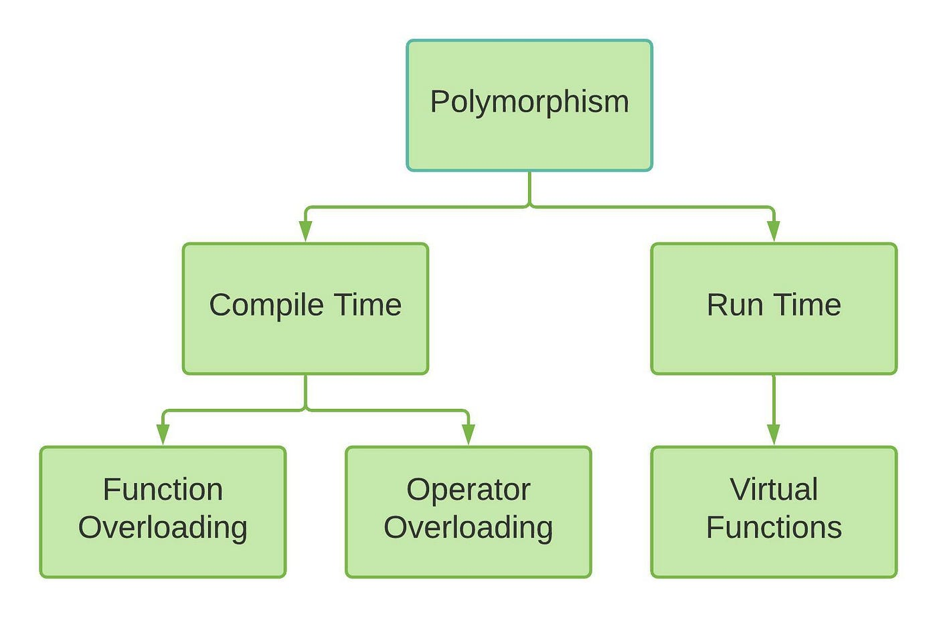

Slide 74
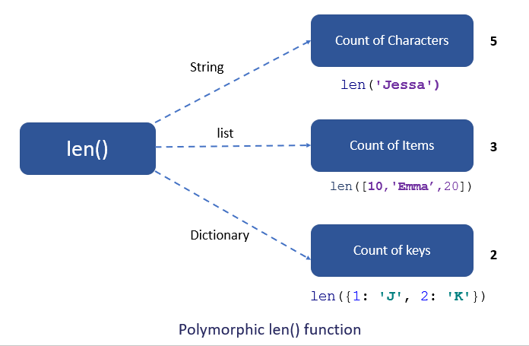

Slide 75
Python Modules
What are python modules
Why we use python modules
Types of python modules
Different ways to import python modules

Slide 76
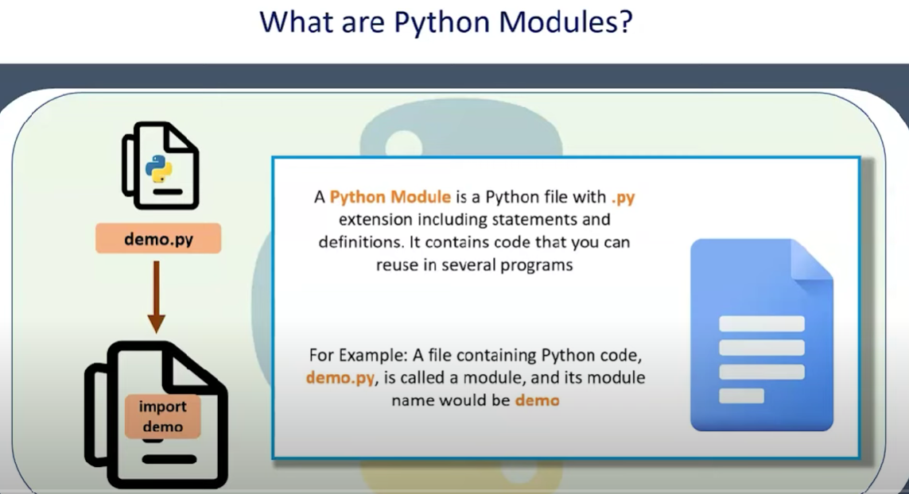

Slide 77
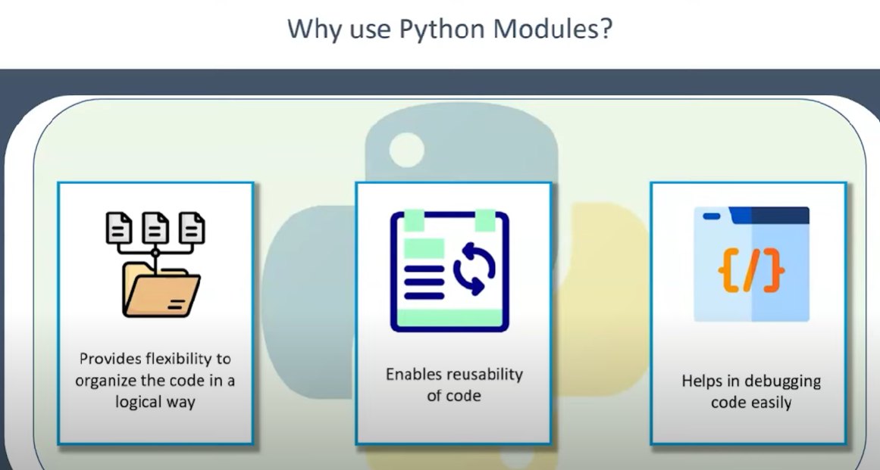

Slide 78
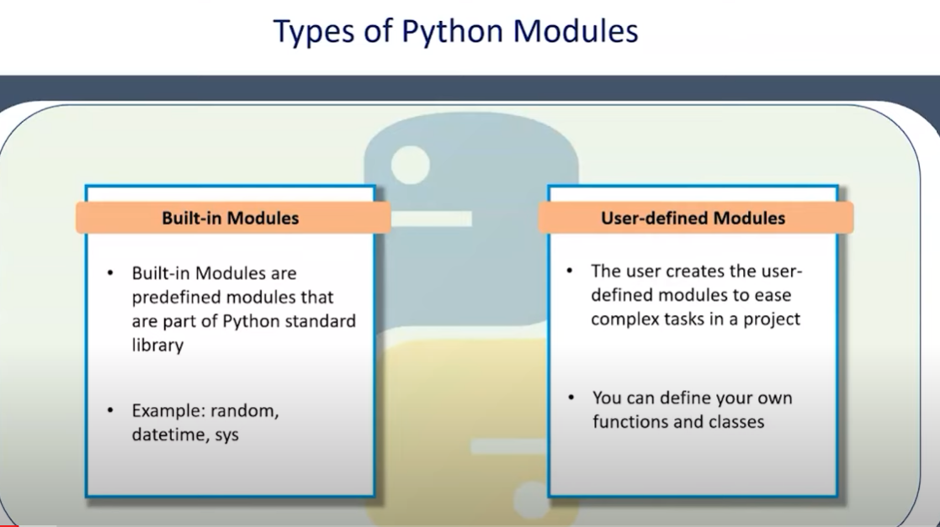

Slide 79
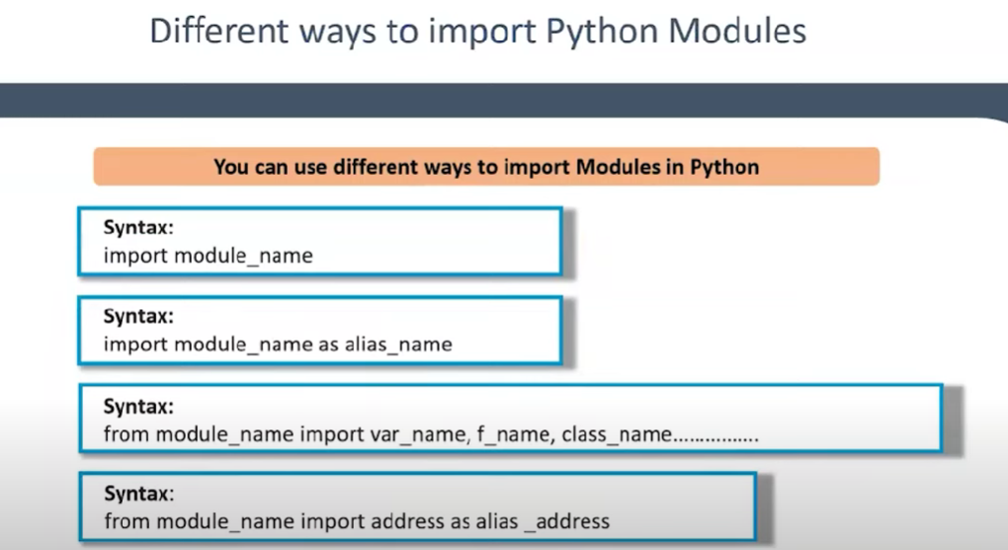

Slide 80
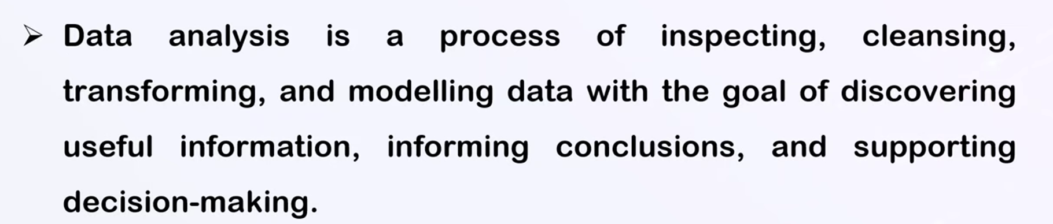
Data Analysis

Slide 81
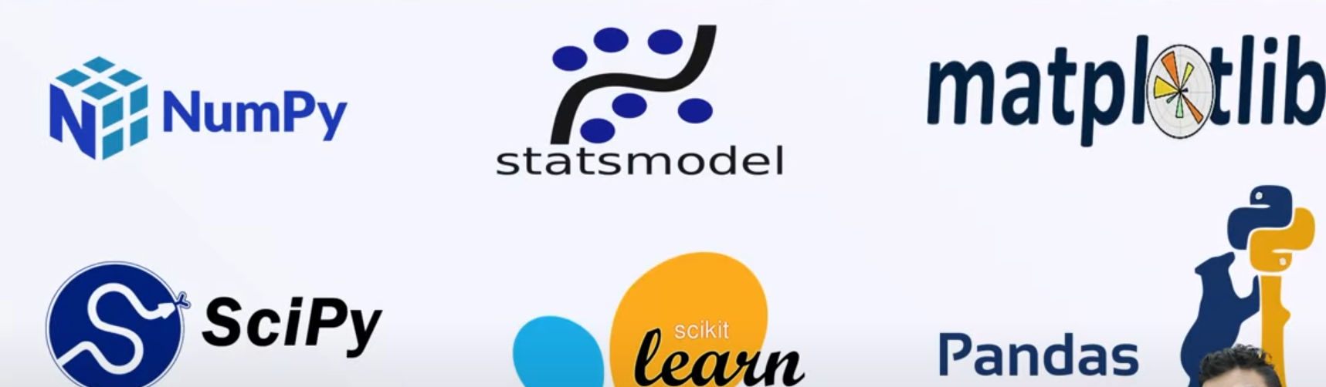
Python Libraries for Data Analysis

Slide 82
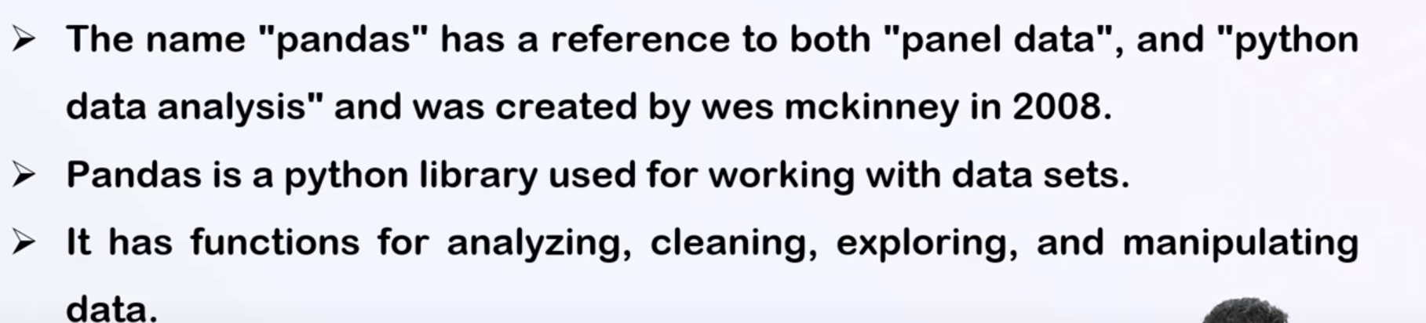
What is pandas

Slide 83
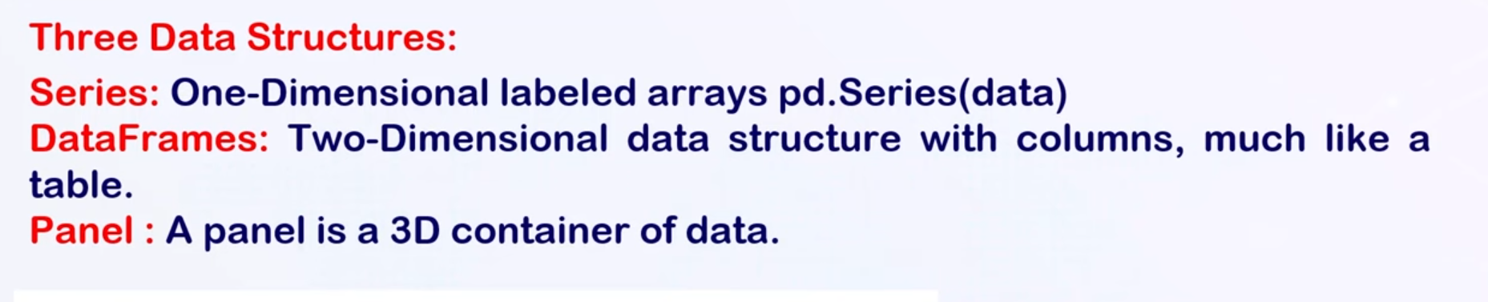
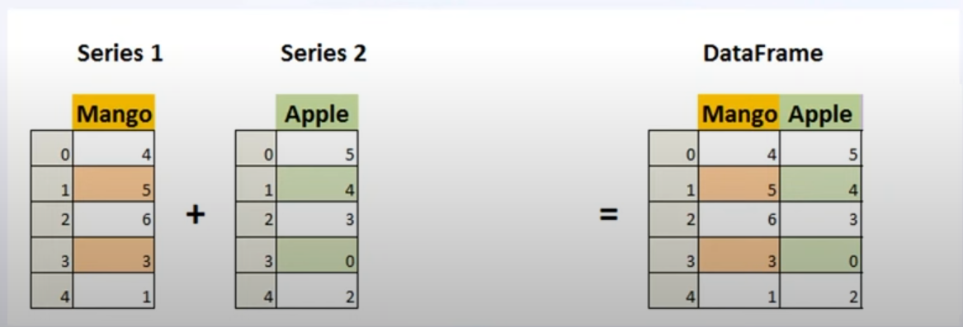
Pandas Data Structure

Slide 84




Pandas Filters
Specific value filter
Columns filter
Rows filter

Slide 85



Pandas Appends
Columns are common

Slide 86

Pandas Merge

Slide 87

Pandas Merge

